Slide 1

City of Houston
2027 Open
Enrollment
Presentation

Slide 2

Humana Group Medicare Advantage
About Humana:
Dedicated to communities around the country for more than 30 years
Over 8.7 million Medicare members just like you, across all 50 states¹
Nationwide network of providers
Providing Medicare plans to beneficiaries since 1987
¹Humana Inc. 2025 Annual Report, February 2026
Notes:
At Humana, we are here to help you make the most of your benefits.
Seniors have been at the heart of Humana’s care delivery since our founding. Humana is one of the nation's most experienced senior care organizations and most trusted Group Medicare Advantage carriers.
About Humana:
Dedicated to communities around the country for more than 30 years.
- Committed to care since 1961.
- Humana started out as a nursing home and hospital company in 1961.
Humana provided its first private Medicare plan in 1985 and has a long and successful history of caring for seniors.
- Humana has been providing Medicare plans to beneficiaries since 1987.
- 31.2 million retirees covered
- Across the country we have 8.7 million members just like you.
Humana follows an award-winning operating model with integrated systems and has the highest Net Promoter Scores in the industry.
- Easily find a provider or hospital within our nationwide network – many of which are in your community.
- Overwhelming satisfaction (94%)
Humana fuses provider and community health relationship models and has expertise and capabilities in value-based care.
- Value-based care model, driving savings and retiree satisfaction
- Delivers better quality of care, better health outcomes and lower costs compared with Traditional Medicare1
- Our ultimate goal is to help people get healthy, get the care they need and help communities across the nation.
Heavily invested in in-home health solutions so seniors get the care they need, while remaining comfortable at home.
- Invested in in-home health solutions, providing seniors the care they need at home
Nationally (The Advantage)1,2
1 Source: https://www.ajmc.com/view/quality-health-and-spending-in-medicare-advantage-and-traditional-medicare
2 Medicare Advantage membership grows 7% for 2023 - STAT (statnews.com)

Slide 3
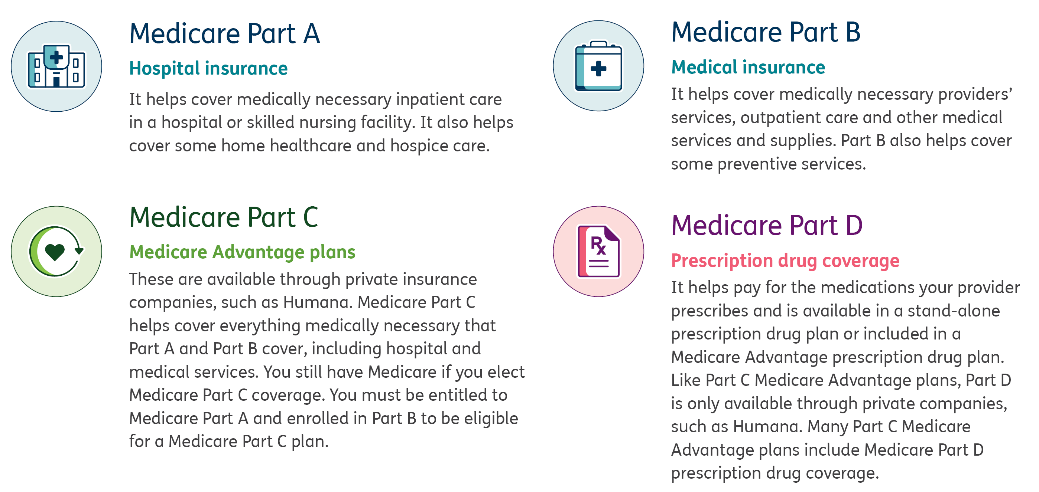
What is Medicare?
Different “parts” of Medicare pay for different types of coverage.
Notes:
What is Medicare?
Medicare is a federal health insurance program for U.S. citizens and legal residents who are 65 and older or those younger than 65 that qualify due to a disability. You can receive your Medicare benefits through the federal government or a private insurance company.
Medicare is divided into parts A, B, C and D. Parts A and B are called Original Medicare.
Medicare Part A
Hospital insurance
It helps cover medically necessary inpatient care in a hospital or skilled nursing facility. It also helps cover some home healthcare and hospice care.
Medicare Part B
Medical insurance
It helps cover medically necessary providers’ services, outpatient care and other medical services and supplies. Part B also helps cover some preventive services.
Medicare Part C
Medicare Advantage plans
These are available through private insurance companies, such as Humana. Medicare Part C helps cover everything medically necessary that Part A and Part B cover, including hospital and medical services. You still have Medicare if you elect Medicare Part C coverage. You must be entitled to Medicare Part A and enrolled in Part B to be eligible for a Medicare Part C plan.
Medicare Part D
Prescription drug coverage
It helps pay for the medications your provider prescribes and is available in a stand-alone prescription drug plan or included in a Medicare Advantage prescription drug plan. Like Part C Medicare Advantage plans, Part D is only available through private companies, such as Humana. Many Part C Medicare Advantage plans include Medicare Part D prescription drug coverage.

Slide 4

Medicare Part C
Medicare Advantage plan
Preferred Provider Organization
Your choice of an in-network
primary care physician (PCP)
No referrals required
Most preventative care is
covered at 100%
Worldwide emergency coverage
Benefit levels are the same for care from both in- and out-of-network providers
Notes:
Key Messages:
Medicare Advantage preferred provider organization (PPO) plans give you the freedom to get care in- or out-of-network. Your benefit plan coverage remains the same, even if you receive care from an out-of-network provider. For more information, refer to your Summary of Benefits located in this packet.
Using a PPO plan
• You’ll have a PCP who will help you manage your care, will get to know your overall health history and can guide you toward preventive care to help you be healthy and active.
• You can use any provider who is part of our network, or you can use any provider who accepts Medicare and agrees to bill Humana.
• Your plan doesn’t require referrals to see other providers, but your PCP can help guide you when you need specialized care.
• Humana Medicare Advantage PPO network providers must take payment from Humana for treating plan members.
• Humana supplies in-network providers with information about services and programs available to patients with chronic conditions.

Slide 5
Your PPO benefits *
Annual deductible | $150
Annual maximum out-of-pocket | $3,500
Hospital care/coverage
Acute inpatient hospital care | $250 per admit
Outpatient hospital coverage | $0 to $20 copay
Doctor office visits/Medical equipment
Primary care provider (PCP) | $20 copay
Specialists | $20 copay
Durable medical equipment | 20% of the cost
Emergency/Urgently needed services
Emergency room | $80 copay for Medicare-covered emergency room visit(s)
Urgent care center | $20
*Cost shares may vary depending on service rendered and the place of treatment. Please refer to your Evidence of Coverage (EOC) for complete description of the
plan’s coverage and services.
Notes:
Key Messages:
With your PPO, your benefit level will be the same amount whether you go in or out of network for care
We have broken up care into Hospital versus Non-hospital to show you what you will pay for each item
You also may have an annual deductible and an out of pocket maximum

Slide 6

Additional benefits included with your PPO plan*
Hearing
Vision
Transportation
Wigs (medically necessary)
*Included, cost share may apply. Please refer to the Summary of Benefits for additional details.

Slide 7

Medicare Part D
Prescription Drug Plan
Prescription drug coverage is available as a part of your Medicare Advantage plan with prescription drug coverage (MAPD)
Generic, brand and specialty drug coverage
List of covered drugs may vary by plan
Access to mail-order pharmacies
Notes:
Key Messages:
What is Medicare Part D?
Medicare Part D is a prescription drug plan (PDP) (insurance for your medication needs).
You use the insurance carrier’s network of pharmacies to purchase your prescription medications. Instead of paying full price, you will pay a copay or percentage of the medication’s cost. The insurance company will pay the rest.
How it works
You must use network pharmacies to enjoy the benefits of our plan, except in an emergency. Pharmacies in the network have agreed to work with Humana to fill prescriptions for our members. If you use a pharmacy outside the network, your costs may be higher.
Our pharmacy network includes access to mail delivery, specialty, retail, long-term care, home infusion, and Indian, tribal and urban pharmacies.
Is your pharmacy in Humana’s network?
You can find a complete list of network pharmacies at MyHumana, your personal, secure online account at Humana.com and the MyHumana Mobile app.* Get printable maps and directions, along with many more details to find a pharmacy that fits your needs.

Slide 8
Your Part D benefits
Humana’s Part D coverage is spread among five groupings based on the drug type—also called “tiers”.
Annual deductible | $0
Annual maximum out-of-pocket | $2,400
Tiers | Standard retail (30-day supply) | Standard mail order (100-day supply)
Tier 1 Preferred generic | $2 copay | $4 copay
Tier 2 Generic | $10 copay | $20 copay
Tier 3 Preferred drug | $40 copay | $80 copay
Tier 4 Nonpreferred drug | $75 copay | $150 copay
Tier 5 Specialty | $75 copay | N/A
Notes:
Key Messages:
The way coverage works with Part D is that each of the major types of prescriptions are broken out into categories or “tiers”
The tiers are typically broken up by whether the drugs are generic, preferred, brand or specialty
You will pay different amounts depending on what type of drug it is
Another factor that determines the cost of your medications is whether you get a 30-day or 100-day supply and whether you pick up your prescriptions in-person from a pharmacy or use a mail delivery pharmacy, like CenterWell Pharmacy - Other pharmacies are available in our network
*Some prescriptions are only available in a 30-day supply.
Initial coverage: You pay the listed copays until your cost share plus the costs incurred for Part D Drugs reimbursed through insurance or a group health plan reaches $2,400. Then Humana pays 100%

Slide 9





Pharmacy options
Retail pharmacy network
  Robust network
  Flexibility and convenience
  Outstanding care & patient experience
  Specially-trained associates
  Enhanced experience
  Comprehensive pharmacy services
  Convenient mail-order solutions
  Safe and secure delivery
Other pharmacies are available in the Humana network.
Notes:
Key Messages:

Slide 10
Preventive care screenings
Protect your health by staying informed about the screenings and treatments you may need.
Immunizations/Vaccines
Influenza (flu)
Pneumococcal (pneumonia)
Women’s health screenings
Breast cancer screening
Cervical and vaginal cancer screening
Bone mass measurement
Men’s health screenings
Prostate cancer screening exam/
Prostrate cancer screenings
Physical exam and health guidance
Annual Wellness Visit
(includes weight, height, body mass index (BMI) and blood pressure)
Colorectal cancer screening
Colonoscopy
Flexible sigmoidoscopy
Home test kit (FOBT/FIT)
Multitarget stool DNA test
Diabetes screening and management
Blood sugar reading by either
HbA1c or glucose monitor
Comprehensive eye exam
Urine test

Slide 11
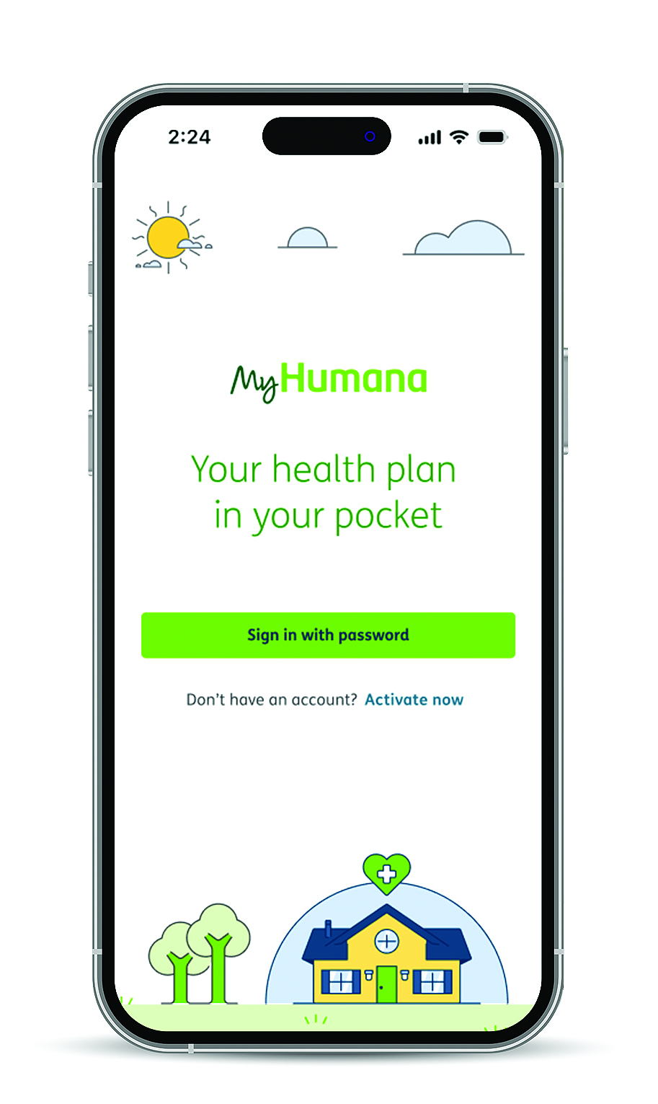
Manage your Humana account online
MyHumana is a secure online portal with tools to manage your plan.
Get your personalized health information on MyHumana
Explore coverage and benefit details the moment you need them
Get your Humana member ID card and add it to your phone’s wallet
Find care close to you and get directions on your phone’s map app*
Review claims status
Access your exclusive member discounts
*Standard data rates may apply
Notes:
Manage your Humana account online
MyHumana is a secure online portal with tools to manage your plan. Sign in or activate your account to get safe, immediate access to your plan information. Then, take your Humana essentials with you wherever you go with the MyHumana mobile app.*

Slide 12
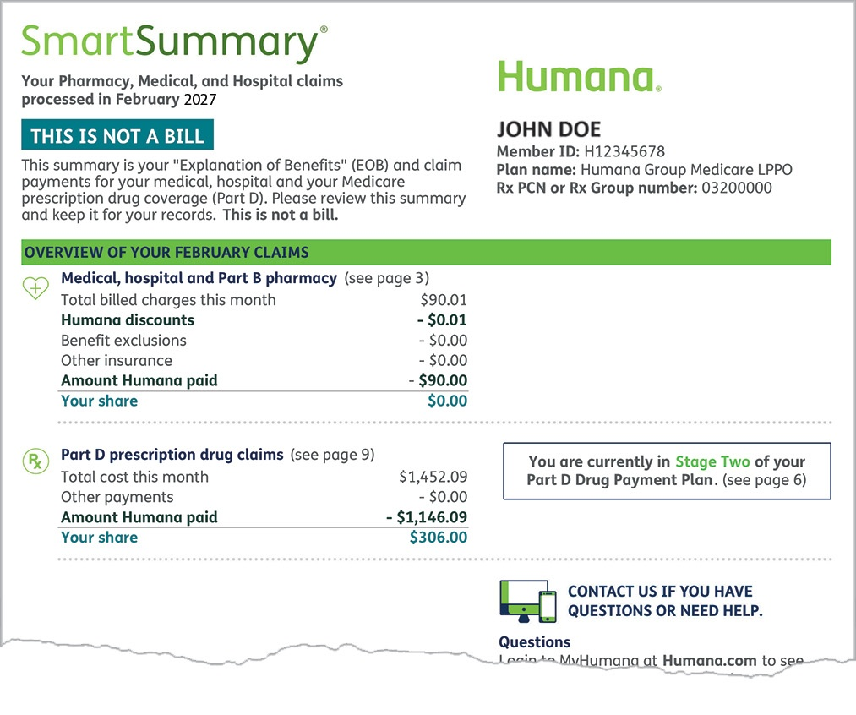
SmartSummary
Your personalized benefits statement
Comprehensive overview of your health benefits and healthcare spending
Statement sent each month after you’ve had a claim
View statements anytime on MyHumana
Go Green via MyHumana if you prefer electronic delivery
Notes:
Key Messages:
Humana’s SmartSummary provides a comprehensive overview of your health benefits and healthcare spending. You’ll receive this statement after each month you’ve had a claim processed. You can also sign in to your MyHumana account and see your past SmartSummary statements anytime.

Slide 13


The Humana Difference
Medicare Advantage provides additional support, included in your plan
Find Care
You can use Humana’s Find Care tool to search for an in-network provider near you.
Humana.com/FindCare
Telehealth
Telehealth visits allow you to connect with your provider online from the comfort and safety of your own home.
Notes:
Find a Doctor
Choosing a doctor, dentist, vision care provider or healthcare facility is an important decision. You can use Humana’s Find a Doctor tool to search for an in-network provider near you.
Humana’s online provider directory is a convenient way to find a current list of doctors, hospitals, other healthcare providers and pharmacies in Humana’s network.
With Humana’s Find Care tool, you can:
Get provider phone numbers, addresses and directions
Customize your search by specialty, location and name
Find out if provider is accepting new patients
Find a provider who fits your needs
Go to Humana.com/findcare
-------------------------
Telehealth
Telehealth visits allow you to connect with your provider online to get the nonemergency healthcare you need—just like an office visit— but from the comfort and safety of your own home.
Telehealth visits allow you to get nonemergency medical care through your phone, tablet or computer*
Telehealth could be used for chronic condition management, follow-up care after an in-office visit, medication reviews and refills, and much more—just like an in-office visit.
--------------------------
Behavioral health
You can also visit mentalwellness.humana.com to search for providers who can help with talk therapy, medication and more. If they offer telehealth, an online appointment may be available to schedule right away. To find additional support options available, you can also log-in to your MyHumana account, and click “Get Care” to view the drop-down menu.

Slide 14

The Humana Difference
Medicare Advantage provides additional support, included in your plan
Clinical support
In-home wellness assessments
Education and resource support
Care management for eligible members
Primary care
Post-hospitalization support
Post-discharge personal home care
- Up to 8 hrs of support with clinical care
Post-discharge transportation
- 12 one-way trips, up to 50 miles per trip
Post-discharge meal program
- 2 per day for 14 days
Notes:
Clinical support
In-home wellness assessments
Humana’s In-home Health and Well-being Assessment (IHWA) is another way to get a detailed health review in your home. Humana makes it easy to have an extra set of eyes and ears for your physician so you can get the care you need and receive helpful resources. In addition, based on the results of your assessment, Humana may suggest resources that can help improve your life, such as regular calls from a nurse or behavioral health services.
Education and resource support and Care Management
Assess members’ current medical conditions, procedures, and discharge plans
Educate members on their health condition(s)
Refer members to appropriate websites, community resources, and health programs
Assist with hospital discharge plans and care throughout treatment
Humana offers a wide variety of Disease Management (DM) programs to assist members who experience chronic or acute health conditions. Programs for Heart Failure, Asthma, Cancer, Diabetes and many more
Transplant Management – Help guide members through transplants by providing information and resources which allow members to make informed decisions
Personal support and counseling
Primary care
Provide a link between members and specially trained clinical staff who can address the member’s unique health-related needs
MyDirectives®, an online advance care plan platform, can help you have a voice in your care when unexpected medical emergencies happen or as illnesses progress.
MyDirectives is easy to use and is available at no additional cost for Humana members.
MyDirectives allows you to have the elements of a medical power of attorney, a do-not-attempt-resuscitation form and organ donation conveniently in one place.
With MyDirectives, you can upload your existing paper advance directive, advance care plan or portable medical order, or you can create a digital care plan in minutes. You can attach video messages and audio files too—whatever you need to feel confident your thoughts and wishes are clear.
Your MyDirectives plan is available to you and your doctors 24 hours a day, 7 days a week. It can be updated anytime.
Post-hospitalization support
Post-discharge Personal Home Care
After an inpatient stay in a hospital or skilled nursing facility, members may receive certain in-home support services following a discharge from a skilled nursing facility or from an inpatient hospitalization. Qualified aides can offer assistance performing activities of daily living (ADLs) within the home (assistance with bathing, dressing, toileting, walking, eating, and preparing meals). A minimum of 4 hours per day, up to a maximum of 44 hours total per year for certain in-home support services.
Post-discharge Transportation
After an inpatient stay in a hospital or skilled nursing facility, members are eligible for up to 12 one-way trip(s) to plan approved locations (per facility discharge) by car, van, wheelchair access vehicle at no additional cost.
Post-Discharge Meals
$0 copayment for Humana Well Dine® meal program. Receive 2 meals per day for 14 days, up to 28 meals delivered to member's home after an inpatient stay in a hospital or nursing facility.
Two refrigerated meals per day, for 14 days (up to 28 meals). Up to 4 discharges per plan year, per eligible member. Overnight, inpatient admission stay in a hospital or skilled nursing facility.

Slide 15


The Humana Difference
Medicare Advantage provides additional support, included in your plan
Go365 by Humana®
A wellness program that rewards you for completing eligible healthy activities like working out or getting your Annual Wellness Visit.*
MyHumana.com
SilverSneakers®
A health and fitness program designed for senior adults that offers fun and engaging classes and activities.
SilverSneakers.com
*Go365 Rewards have no cash value and must be earned and redeemed within the same plan year. Rewards not redeemed before Dec. 31st will be forfeited.
Notes:
Go365 by Humana
A wellness program that rewards you for completing eligible healthy activities, included in your plan at no extra cost.
Go365 by Humana makes wellness fun and easy by tracking your activities and earning rewards you can redeem for gift cards.
Complete eligible healthy activities like walking, getting your Annual Wellness Visit or volunteering to earn rewards to redeem for gift cards. Once you’ve earned at least $10 in rewards, choose your gift cards in the Go365 Mall.
To track your activities online, register at Humana.com/registration. Once signed in, select Go365 from your dashboard—it’s that easy. You can see eligible activities to earn rewards, as well as track your completed activities.
You can get on the right path to a healthier life with the Go365® app. Earn rewards by completing eligible fun and engaging activities that may help you reach your health goals.
Connect your personal fitness devices and apps
Complete activities like walking, getting your Annual Wellness Visit or volunteering
Track your progress and points in the app
Shop rewards at the Go365 Mall
If you have a MyHumana account, you can use the same information to log in to Go365.com. If not, activate your profile at MyHumana.com.
SilverSneakers
SilverSneakers® gives you access to exercise equipment, group fitness classes and social events.
Work towards improving muscle strength, bone density, flexibility and balance.
Use thousands of fitness locations nationwide, with weights, swimming, classes and cardio equipment.*
Enjoy group fitness classes outside of traditional gyms
Start workout programs tailored to your level with the SilverSneakers GOTM app. For more information, or to find a location near you, visit www.silversneakers.com or call 888-423-4632 (TTY: 711), Monday – Friday, 8 a.m. – 8 p.m., Eastern time.
Current SilverSneakers members will have no change to their account or ID card—these will remain the same.
Try SilverSneakers On-DemandTM online workout videos that feature tips on fitness and nutrition.
*Equipment and classes vary by location
Humana is a Medicare Advantage HMO, PPO and PFFS organization with a Medicare contract. Enrollment in any Humana plan depends on contract renewal.
*Go365 is not available on all Humana plans. If you have any questions about your benefits, please call Humana at 877-320-1235 (TTY: 711), 8 a.m. – 8 p.m., Eastern time.
Always talk to your doctor before starting a fitness program.
1 Participating locations (“PL”) not owned or operated by Tivity Health, Inc. or its affiliates. Use of PL facilities and amenities limited to terms and conditions of PL basic membership. Facilities and amenities vary by PL.
Membership includes SilverSneakers instructor-led group fitness classes. Some locations offer Members additional classes. Classes vary by location.

Slide 16
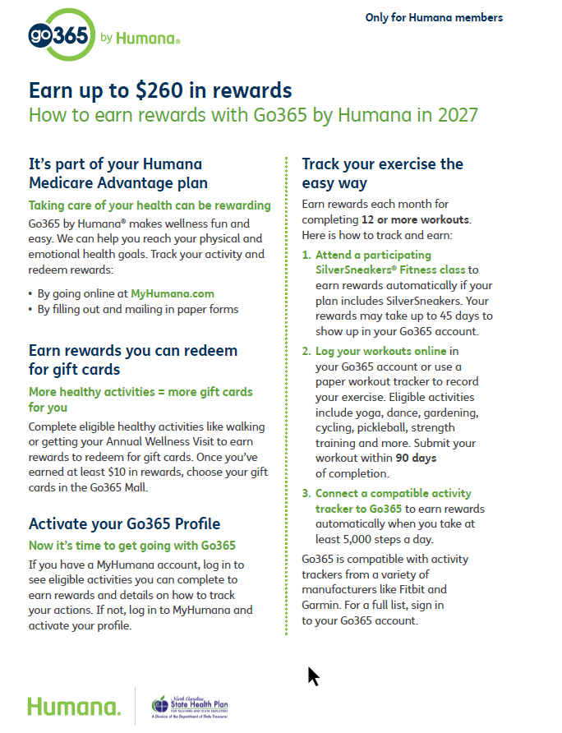



Go365 by Humana – 2027 Program Updates
In 2027, members will be able to earn up to $260 Maximum Earnable Rewards!
Prevention Activities: Annual wellness visit, mammogram, colorectal screening, diabetic bundle, bone density, completion of the medication usage survey
Health Education Activities: Participate in social and health education classes
Exercise & Fitness Activities: Connect a device and/or complete a first workout, and complete minimum of 12 workouts per month tracked via SilverSneakers, fitness device, or online/paper tracker (min 5,000 steps per day)
| 16

Slide 17
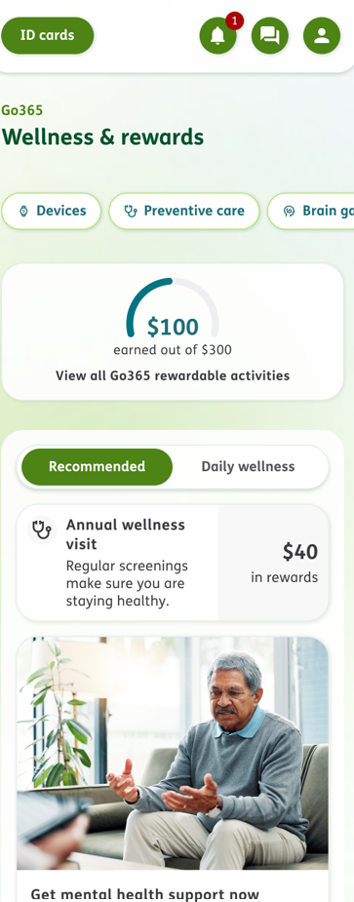
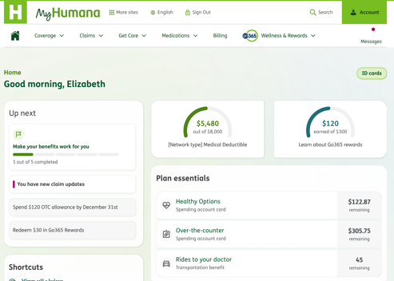
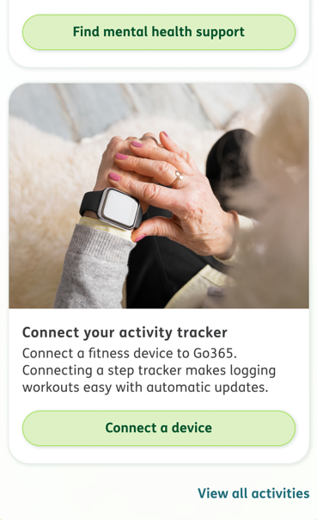
Go365 by Humana – 2027 Program Updates
Go365 is now integrated with MyHumana!
Go365 will be available via the MyHumana Mobile App beginning January 1, 2027!
| 17

Slide 18

How to enroll
Through your employer
Notes:
Key Messages (choose all that apply):
You will be enrolled through your employer

Slide 19
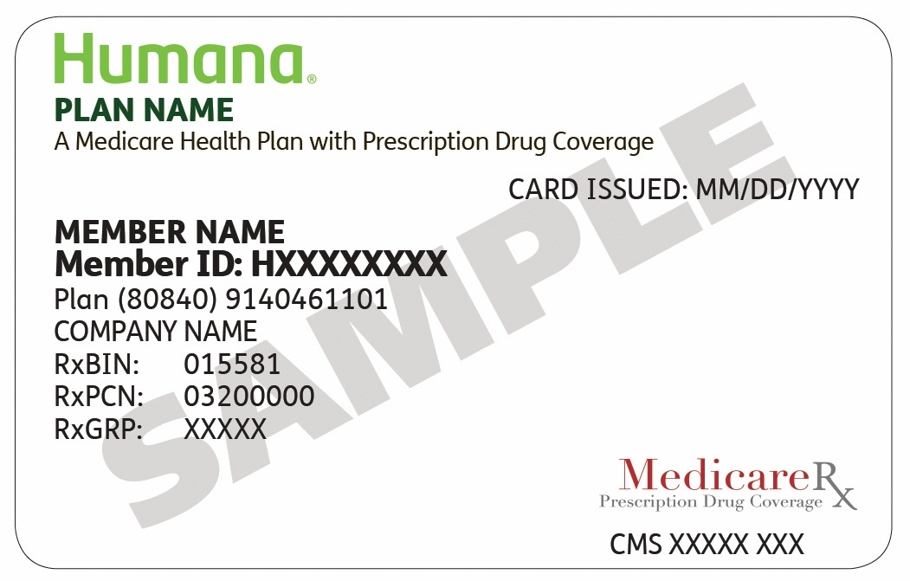
What to expect after you enroll
Enrollment confirmation
Review enrollment information in kit.
Humana member ID card
Once you receive your ID card, create a MyHumana profile.
Access to Evidence of Coverage (EOC)
Read this document to learn about the plan’s coverage and services.
Health and Well-being Assessment (HWA)
An annual detailed health review conducted in your home.
Notes:
• Enrollment confirmation
You’ll receive a letter from Humana once the Centers for Medicare & Medicaid Services (CMS) confirms your enrollment.
• Humana member ID card
Your Humana member ID card will arrive in the mail shortly after you enroll. Once you receive your card, create a MyHumana profile. Having access to your important health documents online, all in one place, is a great way to stay organized, and you can get to your information at any time. To activate your account, visit Humana.com/Registration.
• Evidence of Coverage (EOC)
You will receive information on how to view or request a copy of the Evidence of Coverage documents (also known as a member contract or subscriber agreement). Please read the document to learn about the plan’s coverage and services. This will also include your privacy notice.
• Health and Well-being Assessment (HWA)
This is a yearly detailed health review conducted in the comfort of your home, providing an extra set of eyes and ears for your doctor so you can feel more in control of your health and well-being.
You may receive a call from one of our HWA vendors, Signify Health or Matrix Medical Network, to schedule your assessment. If you have questions, you may ask when they call, or contact Humana at the phone number listed on the back of your member ID card.

Slide 20
Thanks for your time and attention, stay connected with Humana
For more information:
Call Humana Group Medicare Customer Care
team for anything related to your Humana plan
at 866-371-2104 (TTY: 711),
Monday – Friday, 7 a.m. – 8 p.m., Central time.
Visit your.Humana.com/cityofhouston

Slide 21

Humana is a Medicare Advantage PPO plan with a Medicare contract. Enrollment in any Humana plan depends on contract renewal. Call 866-371-2104 (TTY: 711) for more information.
Out-of-network/non-contracted providers are under no obligation to treat plan members, except in emergency situations. Please call our customer service number or see your Evidence of Coverage for more information, including the cost sharing that applies to out-of-network services.
Limitations on telehealth services, also referred to as virtual visits or telemedicine, vary by state. These services are not a substitute for emergency care and are not intended to replace your primary care provider or other providers in your network. Any descriptions of when to use telehealth services is for informational purposes only and should not be construed as medical advice. Please refer to your evidence of coverage for additional details on what your plan may cover or other rules that may apply.
All product names, logos, brands and trademarks are property of their respective owners, and any use does not imply endorsement.

Slide 22


Y0040_GHHLDTUEN_27_OE_City of Houston_M

